Slide 1
Q1 2014 CAR Analysis
Team:
Alan Purvey
Julie Heinzinger
Mark Jessen
CAR Number: 133912654
CAR Number: 133911539
CAR Number: 133912730
CAR Number: 133912451

Slide 2
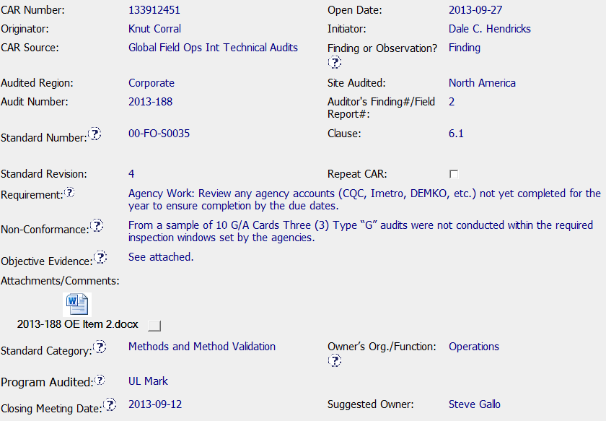
Finding CAR 133912451 – Front End
Good - Requirement matches Non-conformance
Sample size stated
Evidence attached

Slide 3
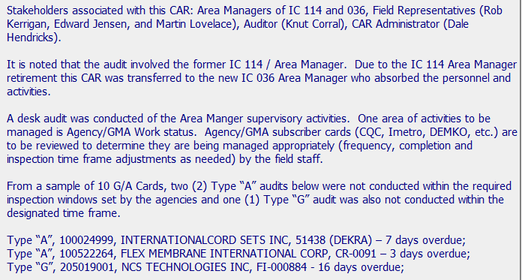
Finding CAR 133912451 – Analysis
Good - Stakeholders Identified
Remainder of Analysis summarizes audit finding and new responsibility – Note that finding cited three “G” and analysis cited 2 “A” and 1 “G”

Slide 4
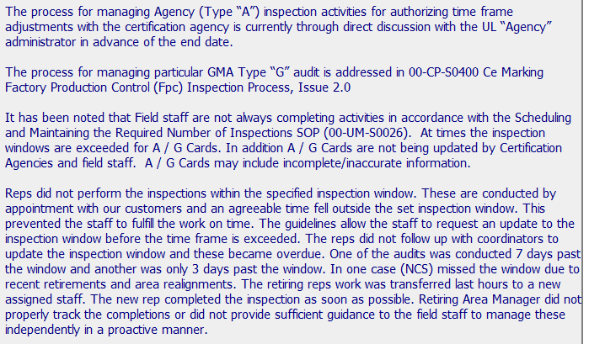
Finding CAR 133912451 – Analysis
Good - Process for A and G noted
Question – Cards not being updated by Certification Agencies, Field Staff and A/G Cards may include incomplete / inaccurate information not addressed further in CAR?
Investigation of root cause begins – 5 Whys to follow
On next slide

Slide 5
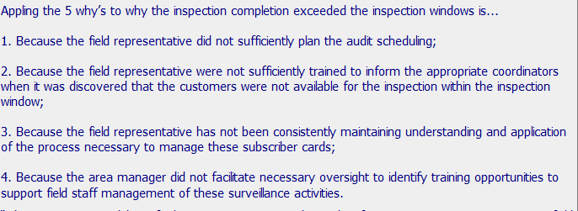
Finding CAR 133912451 – Analysis and Root Cause
Question – 5 Whys - Could additional “whys” have been asked? Why did Field Reps. not sufficiently plan the audits? Not clear why training is required for reaction to not meeting SOP requirements? Could additional causes beyond Area Manager oversight exist here? Additional documented details could have been helpful
Root Cause Statement – Well written and concise. Not clear if this is final root cause given questions above

Slide 6
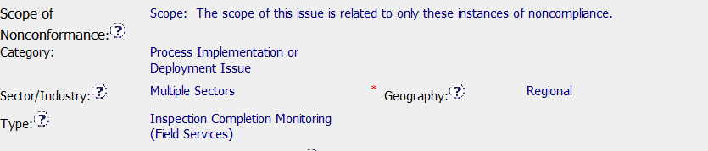
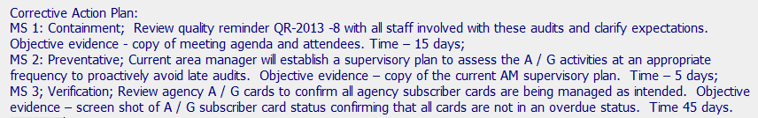
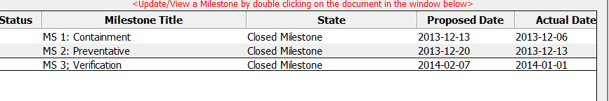
Finding CAR 133912451 – Analysis and Root Cause
Question – Could not identify how scope was determined - No evidence of consideration beyond objective evidence
Corrective Action Plan matches Analysis and Root Cause
Milestones match corrective action plan and contained
Appropriate evidence

Slide 7
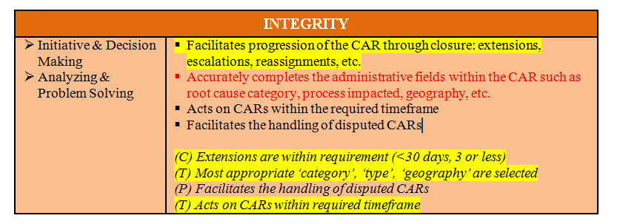
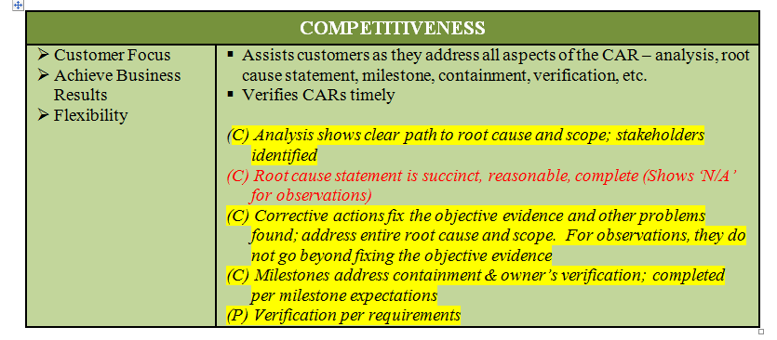
CAR Summary and CBS
CAR SUMMARY- Documenting in the CAR why training and supervisor oversight was determined to be the final root cause would be helpful
Yellow highlighting indicates CBS met
Question – Administrative CBS may not be met due to need to ask additional “whys”
Question – Root Cause CBS may not be met due to need to ask additional “whys”

Slide 8
CAR Calibration Meeting CAR Review
AP Team
Funny Li, Ravi V, Matthew Kim, J.Y. Lee and Kila Yang
February 2014

Slide 9
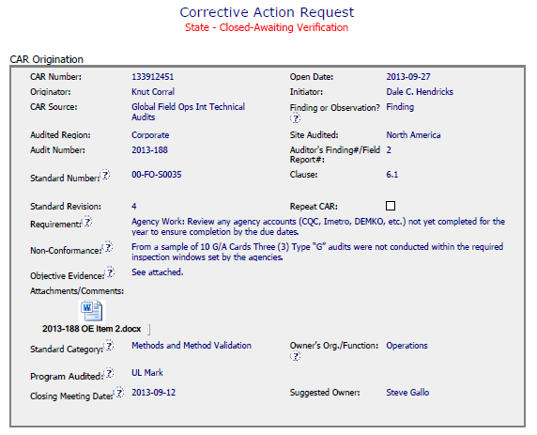
CAR# 133912451
Integrity
Short and clear description of Non-conformance & Objective evidence
All relevant fields filled

Slide 10
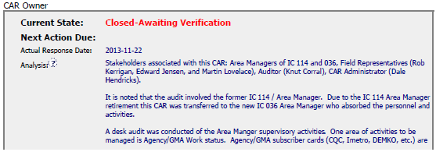
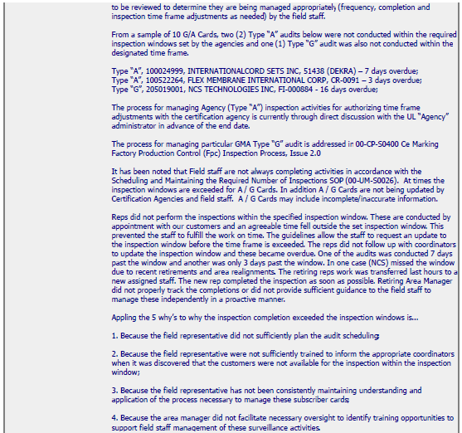
CAR# 133912451
Competitiveness
5 Whys approach for analysis and leads to defining the root cause statement
Stakeholders consultation

Slide 11
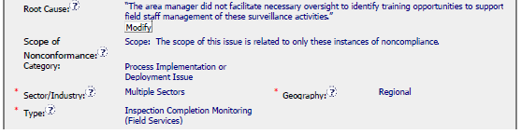
CAR# 133912451
Competitiveness
Precise root cause statement
Clear definition of scope of non conformance
Integrity
All administrative fields filled effectively

Slide 12
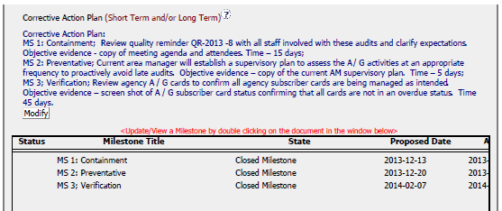
CAR# 133912451
Competitiveness
Three step corrective action plan with 3 distinct milestones
Integrity
All administrative fields filled effectively

Slide 13
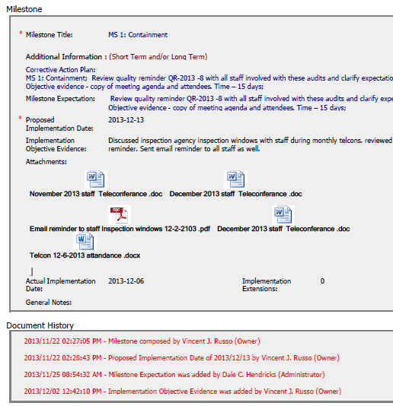
CAR# 133912451
Integrity
Containment milestone with evidence – clear and neat
Competitiveness
Timely review and verification of milestone

Slide 14
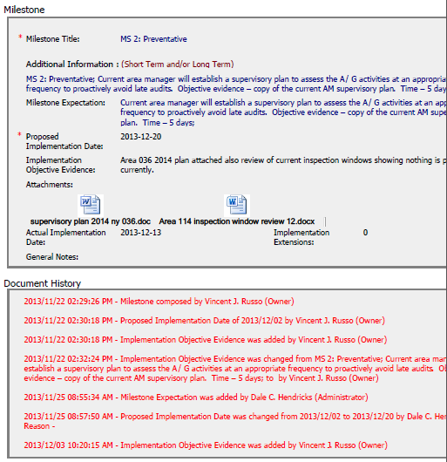
CAR# 133912451
Integrity
Preventative milestone with evidence – clear and neat
Proposed implementation date changed to facilitate implementation, but meets the requirements <30days
Reason is ??
Competitiveness
Timely review and verification of milestone

Slide 15
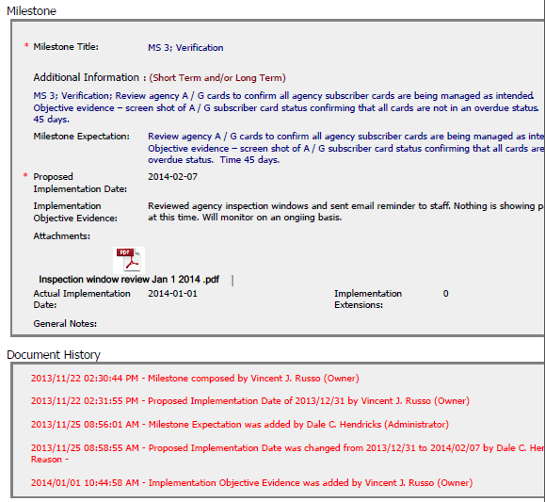
CAR# 133912451
Integrity
Verification milestone with evidence – clear and neat
Proposed implementation date changed to facilitate the implementation
Reason ???
Competitiveness
Timely review and verification of milestone

Slide 16
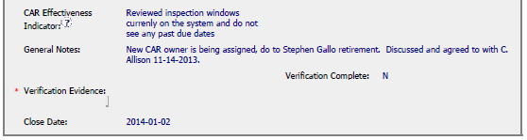
CAR# 133912451
Collaboration
Nice way to close the CAR

